Slide 1
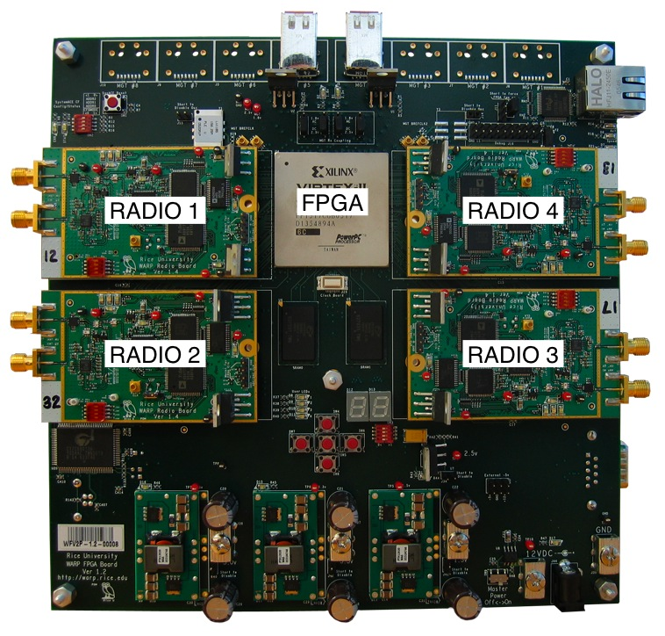
WIRELESS OPEN-ACCESS RESEARCH PLATFORM
Rice University's WARP is a scalable and extensible programmable wireless platform, built from the ground up, to prototype advanced wireless networks.
The WARP project has two broad goals.
●Open-Access Research
● Put "wireless" in wireless curricula

Slide 2
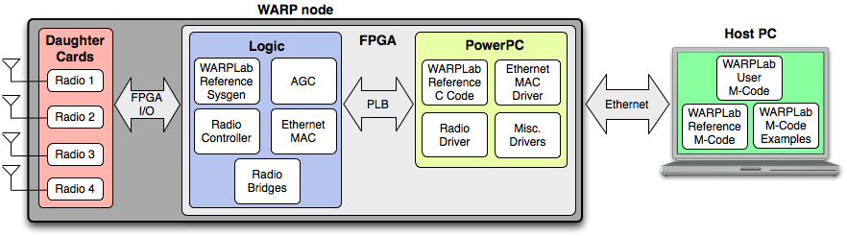
WARPLab Framework Overview
WARPLab is a framework which brings together WARP and MATLAB. With WARPLab, we can interact with WARP nodes directly from the MATLAB workspace and signals generated in MATLAB can be transmitted in real-time over-the-air using WARP nodes. This facilitates rapid prototyping of physical layer (PHY) algorithms.

Slide 3
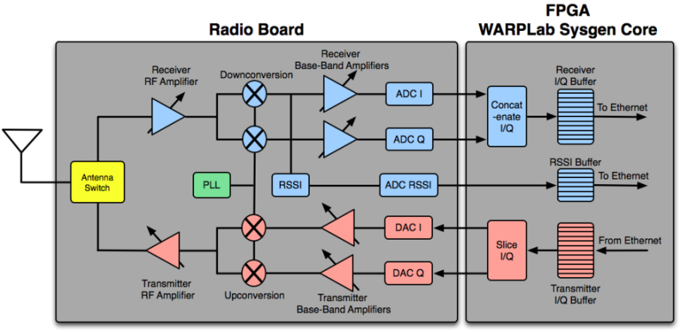
WARPLab FPGA Design Architecture
Tx and Rx paths for one antenna are shown in the figure below, blocks in the Tx Path are highlighted in pink and blocks in the Rx path are highlighted in blue. The blocks are described below.
Blocks on transmitter path:
Tx I/Q Buffers: In-Phase samples to be transmitted are stored in the Tx I Buffer and Quadrature samples to be transmitted are stored in the Tx Q Buffer.
DAC I/Q: Digital-to-Analog Converters for In-Phase/Quadrature samples.
Tx BB Amplifiers: Transmitter Base Band Amplifiers. There are two amplifiers, one for the I signal and one for the Q signal. These are variable Gain Amplifiers both set to the same gain value which can be input by the user from MATLAB workspace.
Upconversion: Converts the base band signal to an RF signal. Carrier frequency depends on PLL setting.
Tx RF Amplifiers: Transmitter RF amplifier, variable gain amplifier, gain value can be input by the user from MATLAB worksapce. continued

Slide 4

WARPLab FPGA Design Architecture
Blocks on receiver path:
Rx RF Amplifier: Receiver RF amplifier, variable gain amplifier, gain value can be input by the user from MATLAB worksapce.
Downconversion: Converts the RF signal to base band In-Phase/Quadrature signals. Downconversion from RF depends on PLL setting.
Rx BB Amplifiers: Receiver Base Band Amplifiers. There are two amplifiers, one for the I signal and one for the Q signal. These are variable Gain Amplifiers both set to the same gain value which can be input by the user from MATLAB workspace.
RSSI: Received Signal Strength Indicator. This block measures the RSSI.
ADC I/Q: Analog-to-Digital Converters for In-Phase/Quadrature samples.
ADC RSSI: Analog-to-Digital Converter for the measured RSSI. The RSSI data is available at 1/4th the rate of the I/Q data.
Rx I/Q Buffers: Received In-Phase samples are stored in the Rx I Buffer and Received Quadrature samples are stored in the Rx Q Buffer.
RSSI Buffer: RSSI data is stored in the this buffer.

Slide 5
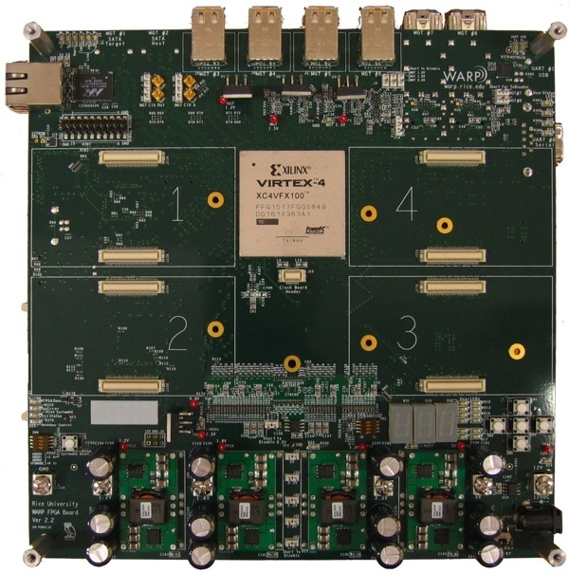
WARP FPGA Board Overview
The WARP FPGA board is a 8"x8" PCB built around a Xilinx XC4VFX100FFG1517-11C Virtex-4 FPGA.

Slide 6
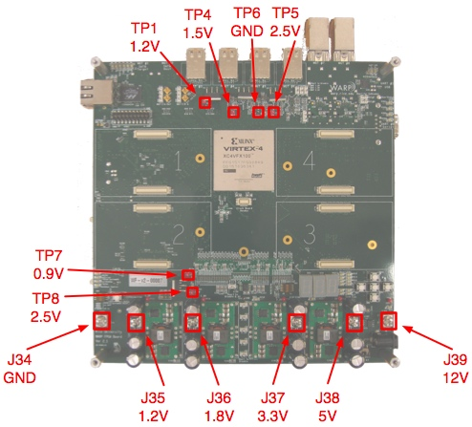
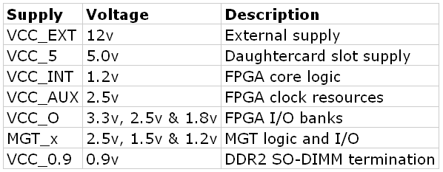
WARP FPGA Board Power Supplies
Required External Supply
The WARP FPGA board operates from a single external 12v supply. This supply is generally connected to the board's coaxial power connector. This connector requires a mating female connector with an inner diameter of 2.1mm, outer diameter of 5.5mm
FPGA Power Supplies
The Virtex-4 FPGA has a number of different power inputs. The table below summarizes the power supplies on the WARP FPGA board.

Slide 7
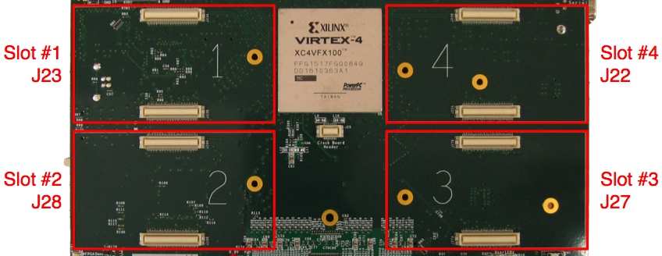
WARP FPGA Board Daughtercard Slots
The WARP FPGA Board has four daughter card slots. The four slots are electrically and mechanically identical. The WARP hardware supports any combination of daughter cards in the four slots. However, a given FPGA design will require a specific arrangement of daughter cards once synthesized.

Slide 8
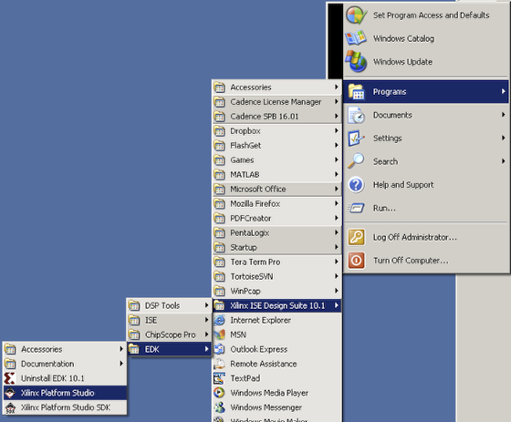
WARPLAB TOOLS
The Xilinx Tools suite is used extensively for WARP development. EDK and ISE are required for working with complete projects
This section describes the process of launching XPS and creating a simple hardware/software platform using Base System Builder. This section of the tutorial is specifically created for FPGA Board v2.2
continued
Base System Builder - FPGA Board v2.2

Slide 9
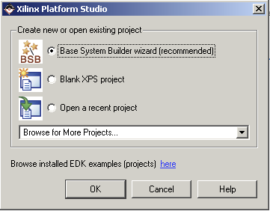
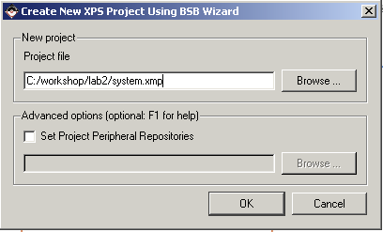
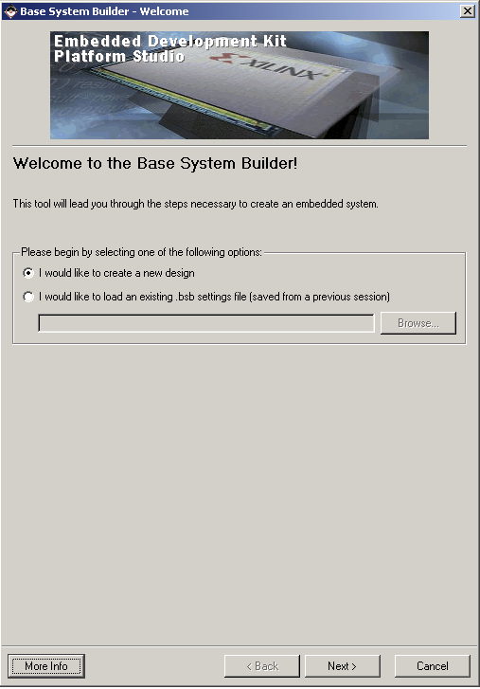
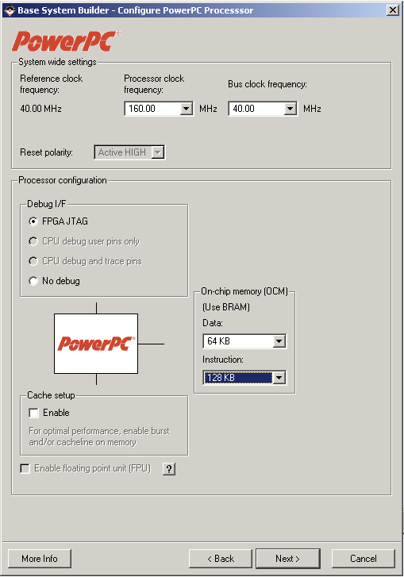
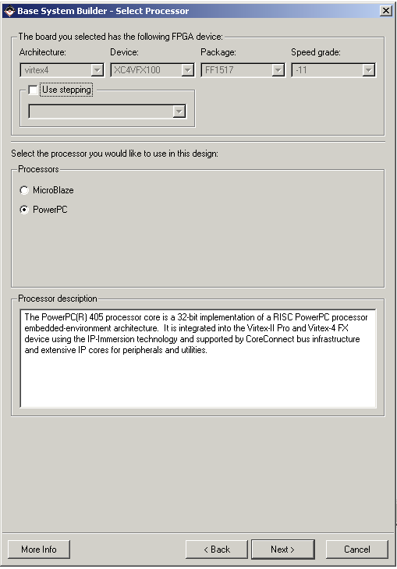
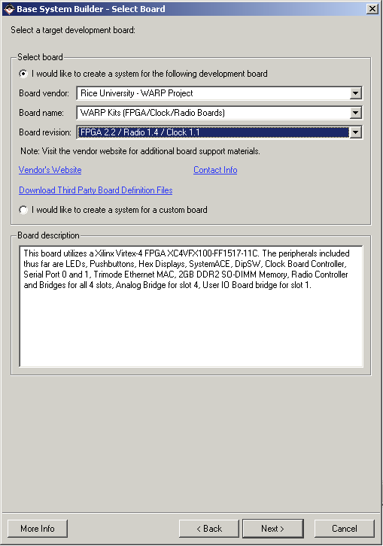
Base System Builder - FPGA Board v2.2

Slide 10
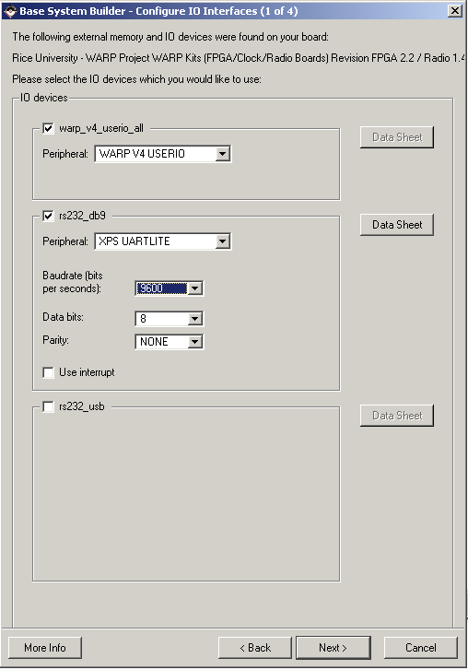
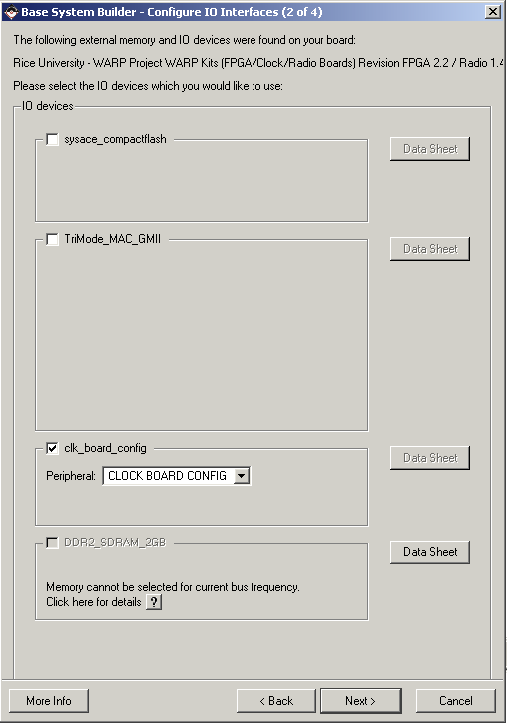
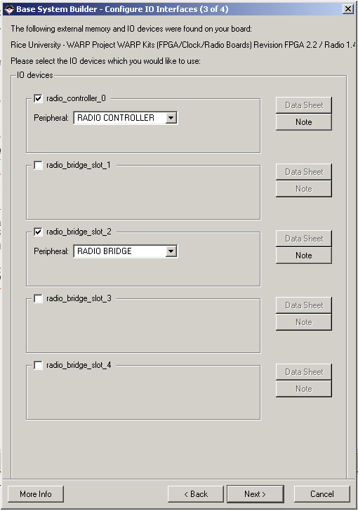
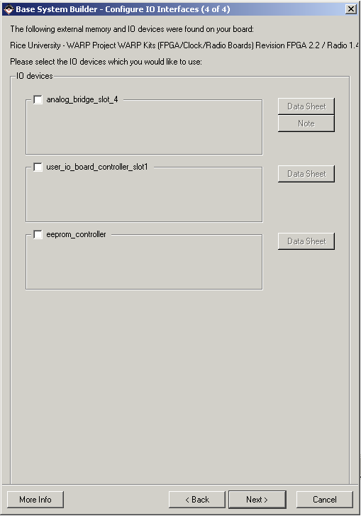
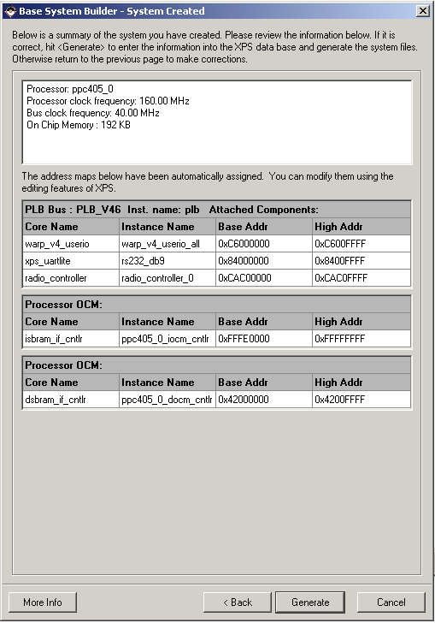
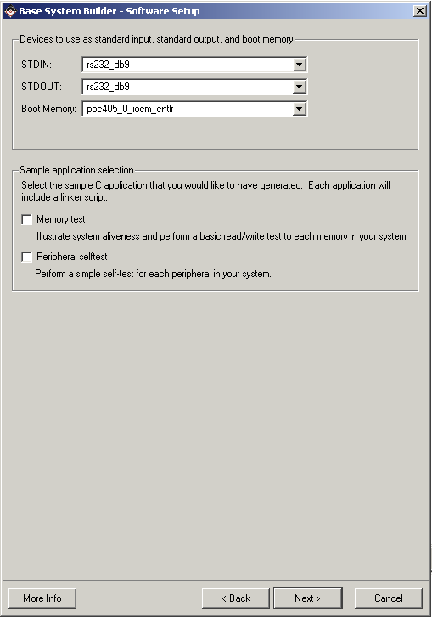
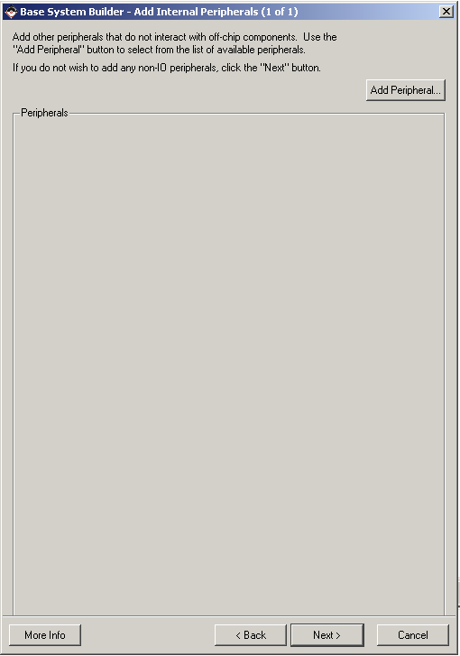
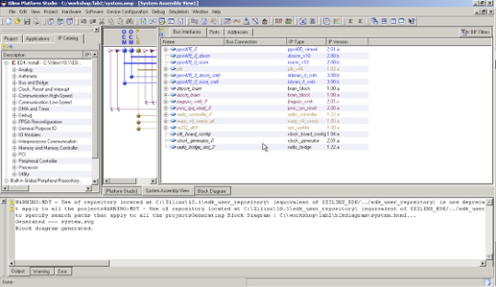
Base System Builder - FPGA Board v2.2

Slide 11
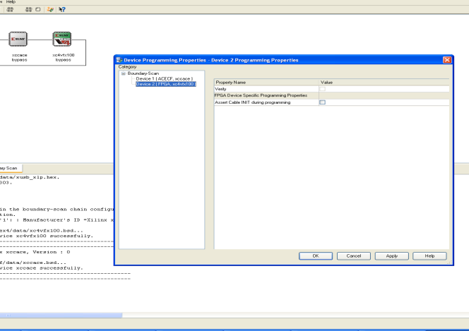
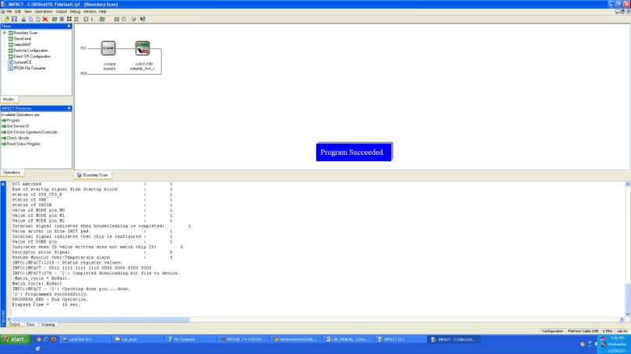
UPLOADING BITSTREAM TO THE BOARD
The iMPACT software application supports communication (including FPGA configuration) between a computer running IMPACT and devices on the WARP FPGA board configured in a "scan chain". In such a chain, serial data is fed from the output of each device to the input of its nearest downstream neighbor. The first and last devices in the chain are connected back to the PC via dedicated USB boundary scan circuitry on the WARP FPGA board. Establishing communication via this link is a critical first step in utilizing the WARP hardware.

